Slide 1
Trees for Peace- A Valentines Day Gift to the Planet
Project by Shtrii Shakti
YUVAH AKAASH
For One Billion Rising Day

Slide 2
One Billion Rising Valentines Day Feb 14
“In short, trees give peaceful and abundant life– we humans have the knowledge and power to create and multiply them”
One Billion Rising is a movement to stop gender violence and poverty
This day is celebrated with Acts of Love and Peace
One thing S2 is doing on this day is to plant Trees For Peace because Trees give us Clean Air, Trees give us shelter as shade and keep urban microclimates controlled, Trees promote soil health which gives us clean water, Trees give us and animals fruit and fodder.

Slide 3
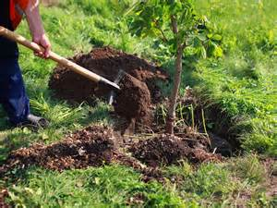
Why Plant Fruit Trees & Native Trees
Fruit Trees help with shade, air quality, and food security
Native Trees are good for local birds & other wildlife, often require less watering and pest-control, often grow taller and faster, and many are good for livestock to eat as fodder
We should see the size and needs of each site to determine what kind of tree would thrive there and serve the needs of the org/community/household. (how much area is available? Are there cows that need fodder vs. schoolchildren who want fruit?)

Slide 4
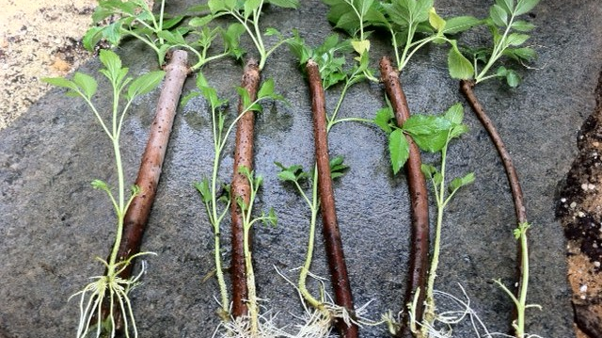
Why Learn how to Root Trees
Trees are natural and while it is easy to buy from Nurseries, it is good to realize that trees can be mostly free and that each person has the ability to create a forest should they so choose.
A tree rooting workshop can be a group learning tool, and after the workshop the knowledge can be passed on.
Oftentimes urban dwellers do not learn agricultural or horticultural skills, so this activity helps to bridge the knowledge of the concrete jungle with that of the natural world
Realistically, cities can be lush and luxurious forests too!

Slide 5
How to make a tree – 10 steps—1 year
Take a cutting of a stick from the newly growing tip end of a branch 20-30cm
Remove the bottom 10-15cm of leaves
Thin to 50% remaining top leaves and
Soak in clean water 30 min-1hr
Lightly scratch the bark on the bottom 5-7cm of bare stick –this is where roots will form
Dip in rooting compound hormone or other traditional mixture (follow package or recipe directions)
Place in loose fluffy soil or soilless media that is as sterile as possible. Plant deep, so only the top half or third is visible, and water
Place a clear plastic bag with holes on top like a mini greenhouse (for humidity)
Store someplace bright but not in direct sun! Fertilize with organic fertilizer routinely. Organic is safer because O.D. of chem fertilizer can kill the plant.
Water every morning for a few months. If the stick and leaves do not dry out, then roots have formed. Ready to plant after 8-12 months.

Slide 7
Steps 1-4 you will need a clean knife or plant clippers and clean hands (to prevent infection to the cutting)

Slide 8
Steps 5-7 You will need clean tools, disease free soil, and a light touch Follow Directions for Safety!

Slide 9
Steps 8-10 you will need patience, care, water and organic fertilizer watering and fertilizing for 8-12 months

Slide 10
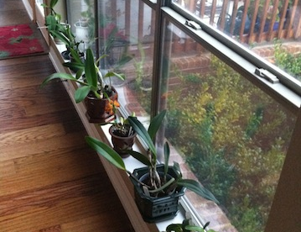
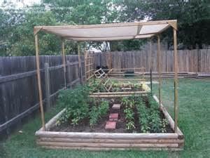
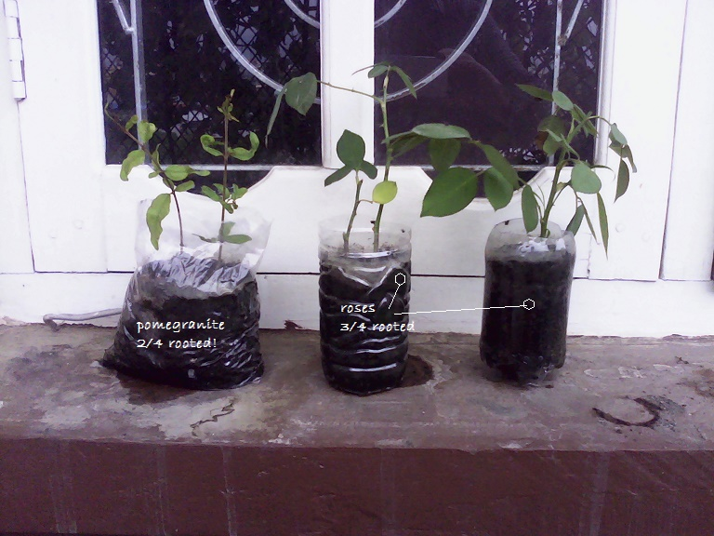
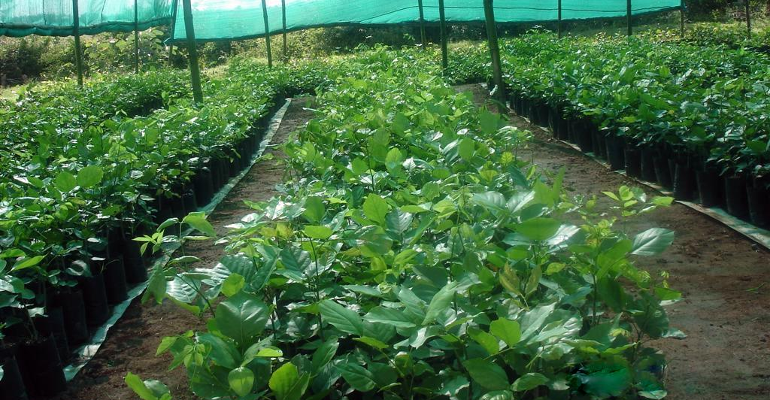
The plants need indirect sunlight, Daily Water, and 1x per week Organic Fertilizer
We can keep them on the balcony upstairs, or along the side of the fence where they will receive light, won’t get bumped too much, but won’t get hot bright afternoon sun
I like to use old water or soda-pop bottles as pots because they are tall and sturdy. I cut holes in the bottoms and poke holes in the sides for drainage

Slide 11
You can do this in your Organization or at home
MATERIALS YOU WILL NEED
Old plastic bottles or bags, or some other container with holes in the bottom. CLEAN THE CONTAINER and let it dry before use
Soil or Soilless Media (google it). Use healthy soil, not wet, mouldy, sick soil
rooting hormone or a cinnamon and honey mixture (google it). Follow the directions.
clean knife or scissors
plastic bag with holes to place over top like a mini-greenhouse
a FRESH cutting 20-30cm long from a tree that you want to duplicate

Slide 12
Some Advanced Links
http://www.gardeningknowhow.com/edible/fruits/avocado/avocado-tree-cuttings.htm
https://deepgreenpermaculture.com/diy-instructions/propagating-hardwood-cuttings/
There are many youtube videos available if you search for “Rooting Fruit Trees” or “Propagating Trees from Cuttings”

Slide 13
THE END ☺

